Slide 1

Chapter 4 Workflow: basics Follow along here: https://r4ds.had.co.nz/workflow-basics.html
Source:https://r4ds.had.co.nz/

Slide 2
Weekly Strategy
Powerpoint slides with chapter highlights
Chapter review, e.g., workflowbasics.R
Practice coding examples from book together
Work on assignments time permitting
Complete or review the assignment at the beginning of the next scheduled class
Contact me through meetup with question between our meetings

Slide 3
Getting started
Rstudio download?
Open Rstudio
Click on icon or open workflowbasics.R
Pane layout
Source Editor
Console
Workspace Browser (history, environment)
Plots, Files, Packages, Help

Slide 4
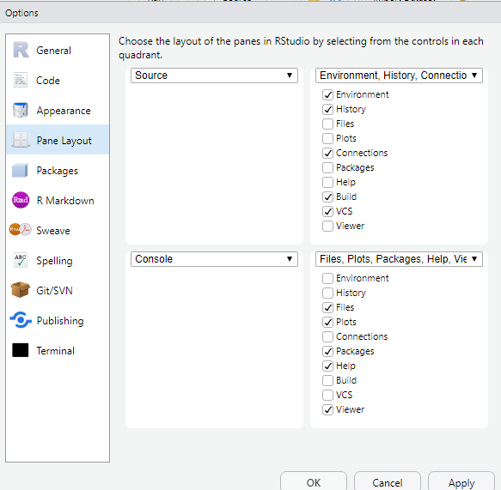
To set up panes:
Tools
→Global Options
→Pane Layout

Slide 5
Rstudio Panes
Source Editor
type code
can save as scripts
as .R text files
Environment/History
view objects
view command history
Console
code is evaluated here
Files
Plots
Packages
Help

Slide 6
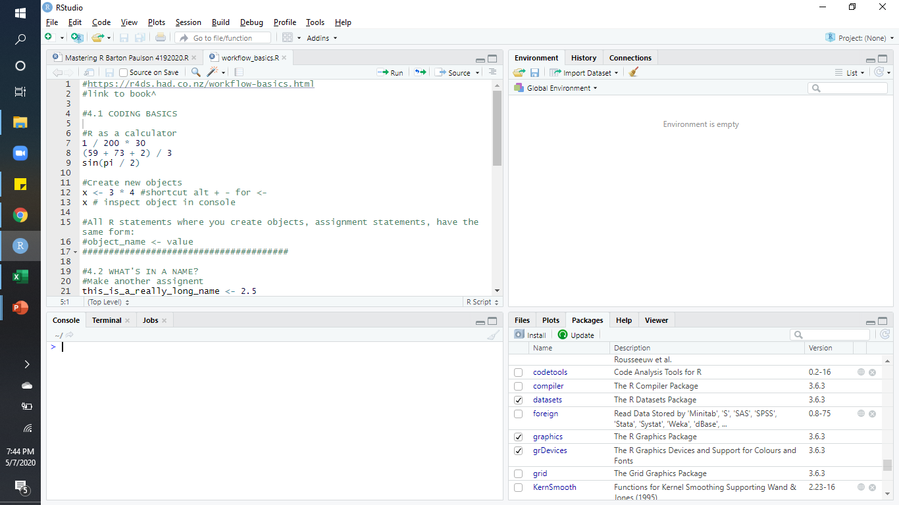

Slide 7
4.1 Coding Basics
You can use R as a calculator
in the editor or the console
You can create new objects with <-
shortcut is Alt + the minus sign. Alt –
You create objects with using the assignment statement
object_name <- value

Slide 8
4.2 What’s in a name?
Name must start with a letter
Name can only contain letters, numbers, _ and .
Name should be descriptive
RStudio completion facility
type first unique characters then TAB
Object name will appear

Slide 9

4.3 Calling functions
R has many built-in functions that are called like
this:
To find function type first characters then TAB
Select function using ↑/↓ arrows and TAB once more

Slide 10

4.3 Calling functions
Quotation marks and parentheses
R will fill in the 2nd “ or )
+ sign in console indicates 2nd “ or ) is missing
R is waiting for more input

Slide 11


4.3 Calling functions
Viewing the assignment value(s)
Assignment statement then enter object name:
OR surround assignment with parentheses:

